Slide 1
Week 3 - Selectors
QA Automation Course

Slide 2
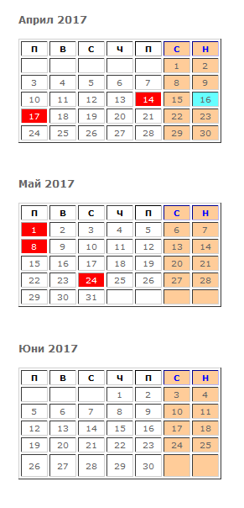
Should we move the course to Tuesday?

Slide 3
Homework review

Slide 4
What we’ll do today
CSS selector
Xpath selector

Slide 5
Last week selectors
By.ClassName
By.Id
By.Name
Example usage:
driver.FindElement(By.ClassName("map-search"))

Slide 6
Selectors
By.LinkText
By.PartialLinkText
By.TagName
By.CssSelector
By.XpathSelector

Slide 7
CSS selectors
https://saucelabs.com/resources/articles/selenium-tips-css-selectors; http://www.testingexcellence.com/css-selectors-selenium-webdriver-tutorial/
Search for “Selenium CSS examples”
Examples:

Slide 8
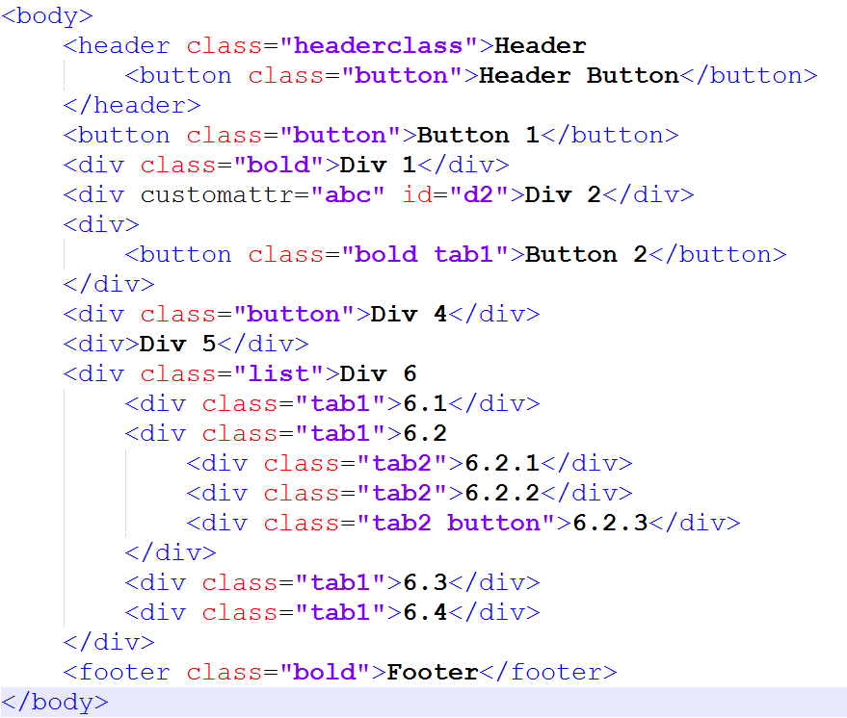
“header” element
“body header.headerclass”
“header.headerclass”
“.headerclass”
“6.2.3” element
“html body div.list div.tab1 div.tab2.button”
“.tab2.button”
Which elements is:
“div.button”
“.button”
“div.tab1”

Slide 9
Nth-of-type(n)
“div.list div:nth-of-type(2)” => 6.2
Nth-child
Last-child first child
#id
div#d2 => Div 2
element_name[<attribute_name>='<value>']
div[customattr=‘abc’]
Contains
*=
$=

Slide 10
Xpath selectors
https://www.w3schools.com/xml/xpath_intro.aspSearch for Selenium xpath examples
Examples

Slide 11
“header” element
“/html/body/header”
“//header[@class=‘headerclass’]”
“6.2.3” element
“/html/body/div/div/div[3]”
“//div[@class=‘list’]//div[5]”
. Matches current element
“/html/body” === “/html/./body”
* Matches any element
“/html/body/*[@class=‘bold’]”
“/html/body//*[@class=‘bold’]”
.. Matches parent element
“//*[@class=‘bold tab1’]/..”
Text() Matches parent element
“//*[text()=‘Div 2’]”

Slide 12
Demo (if we have time)
https://yavlenawebsite.melontech.com/properties/all/%D0%A1%D0%BE%D1%84%D0%B8%D1%8F%20(%D1%81%D1%82%D0%BE%D0%BB%D0%B8%D1%86%D0%B0)/%D0%A1%D0%BE%D1%84%D0%B8%D1%8F/?view=Hybrid
Expand “Тип имот“
driver.FindElement(By.XPath(
"//input[@placeholder='Тип имот']/../a[@class='dropdown-trigger']“
)).Click();

Slide 13
Conclusion
Use Ids whenever possible
Use css selectors
If you can’t find good other way – use Xpath

Slide 14
Homework
Choose number (5 digits)
Tsanka 67890
Aleks - ?????
Mitko 74352
Eva 10125
Dido 84111
Pesho 66666
Stefan 46305

Slide 15
Homework
https://yavlenawebsite.melontech.com/propertylist
Digit 1: Услуга
Digit 2: Тип имот
Digit 3: Вид имот
Digit 4+5: Област
Choose “Град“ that has some properties
Create a test that:
Opens the url
Clicks on the respective Услуга, Тип имот, Вид имот, Област, град depending on your number and choice of City
Click on “Свържи се с брокер” button for the (preferably) second property in the list
Commit and push the test

Slide 16
Q & A

